Slide 1
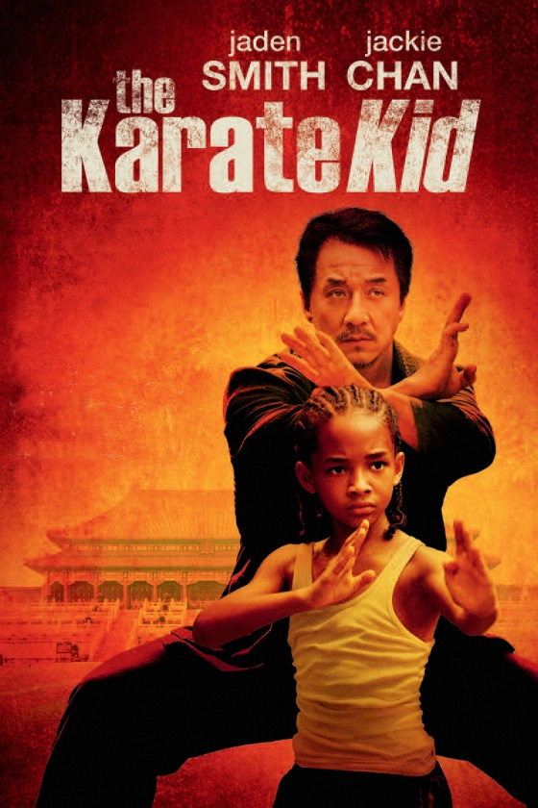
PRESENTED TO:
MA’AM NAYAB WAQAS
PRESENTED BY:
MAKAH SIMRAH KHAN
(F2022065037)
TAHIRA
(F2022065017)
LAIBA ARIF
(F2022065040)

Slide 2


The Karate Kid_Film Makers
Director
Roger Pratt
Harald Zwart
Cinematography
Writer
Robert Mark Karmen
Music by
James Horner
Christopher Murphey
François Séguin
Screenplay
Production
Release on
June 7, 2010
(USA)
Casting by
PoPing AuYeung
Zoe Thompson

Slide 3
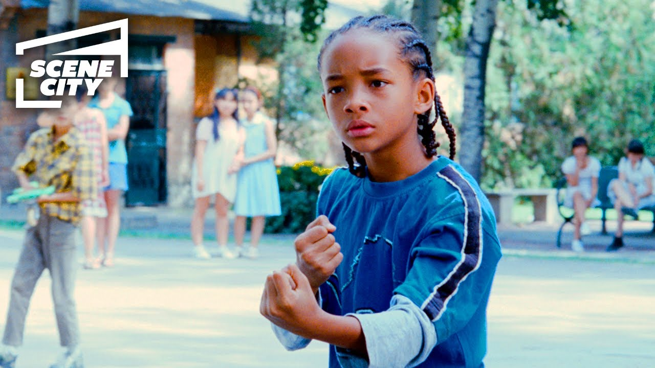
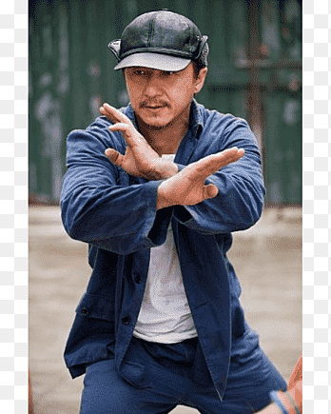
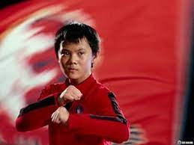


The Karate Kid_Main Actors
Real Name: Jaden Smith
Character Name: Dre Parker
Real Name: Zhenwei Wang
Character Name: Cheng

Slide 4
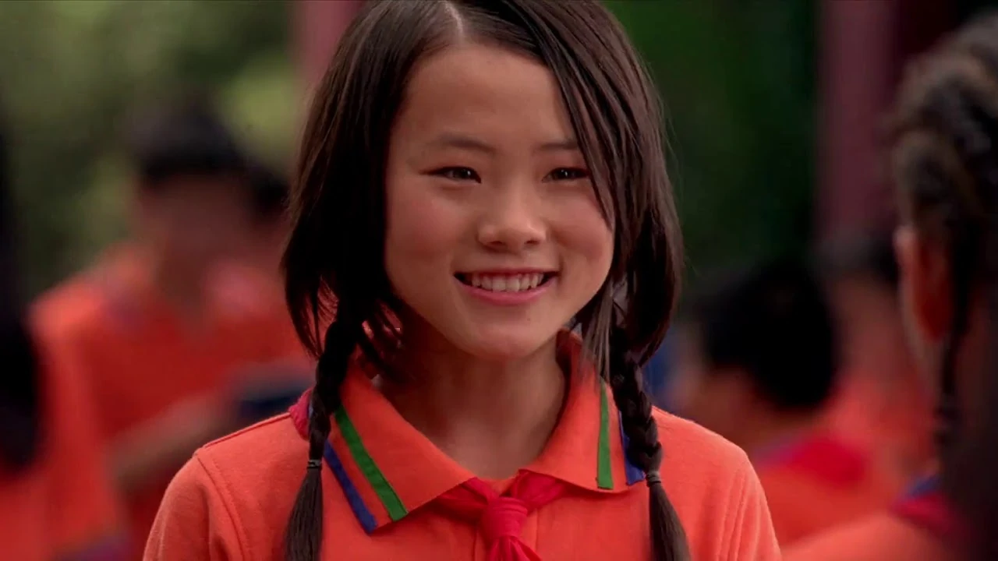
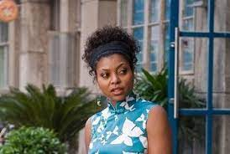
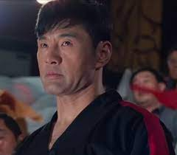


The Karate Kid_Main Actors
Real Name: Wenwen Han
Character Name: Meiying
Real Name:Rongguang Yu
CharacterName: Master Li

Slide 5
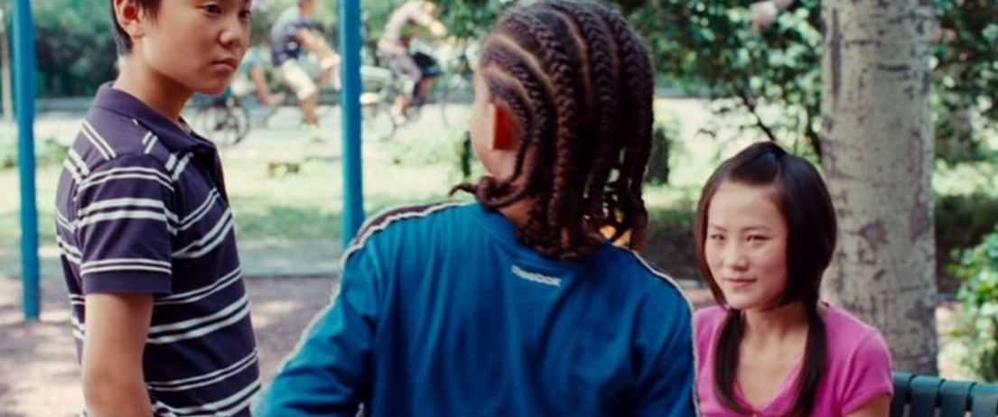

12-year-old Dre Parker and his mother, Sherry ,arrived in Beijing.
Dre develops a crush on a young violinist, Mei Ying.
Cheng, a kung fu prodigy, started harassing and humiliating Dre in and around the school.

Slide 6
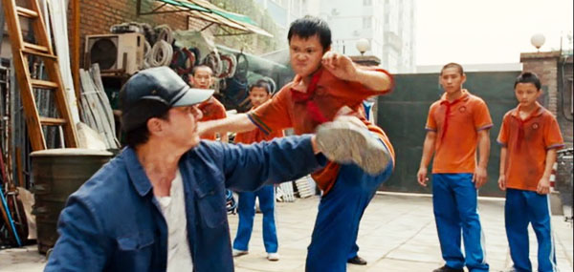
Climax of Story
During a brutal beating of Dre by Cheng and his friends ,the maintenance man Mr. Han came and stop them by using his Kung Fu tricks .
He used old method of fire cupping to heal up Dre’s wounds.
Mr. Han denied to taught him kung fu.
Rule of Master Li:
No Mercy, no weakness, no pain
Brutal challenged Dre to a fight with Cheng in a tournament.
This climax changed the Dre’s life

Slide 7
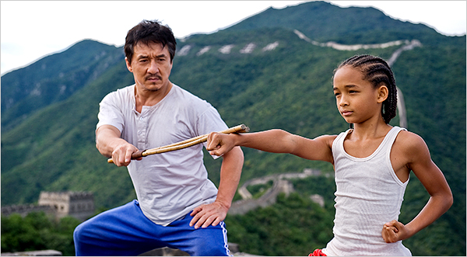
What kung fu is ?
Kung fu is not about punches and parries, but maturity and calm, Dre realized that facing down the bullies will be the fight of his life.
How he prepared himself for Tournament?

Slide 8

Mr. Han Training his Student Dre Parker

